Slide 1
1
Newton’s Method

Slide 2
2
The Newton’s Method is one of the most popular and powerful iterative method for finding roots of the nonlinear equation
f(x) = 0 .
It is also known as the method of tangents because after estimated the actual root, the zero of the tangent to the function at that point is determined. It always converges if the initial approximation is sufficiently close to the exact solution.

Slide 3
3
This method is distinguished from the methods of previous sections by the fact that it requires the evaluation of both the function
f(x)
and the derivative of the function
at arbitrary point x.

Slide 4
4
The Newton’s method consists geometrically of expanding the tangent line at a current point _______until it crosses zero, then setting the next guess ____________ to the abscissa of that zero crossing, This method is also called the Newton-Raphson method.

Slide 5
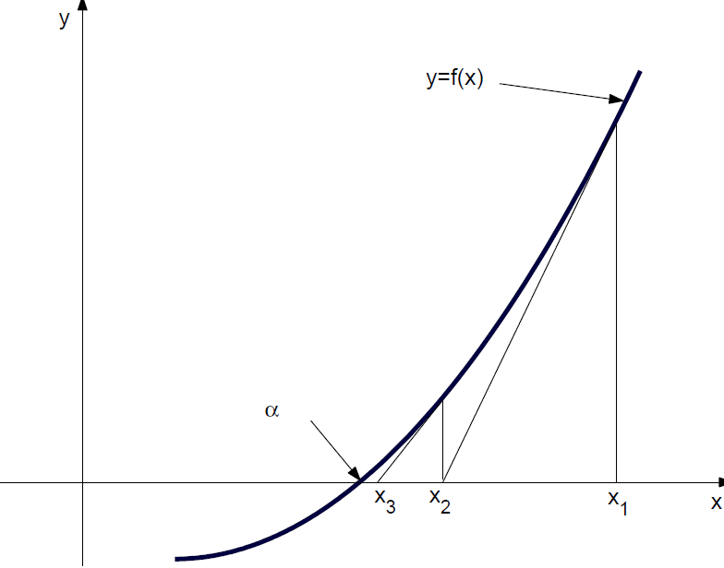
Graphical Solution of Newton’s Method.
5

Slide 6
6
There are many description of the Newton’s method. We shall derive the method from the familiar Taylor’s series expansion of a function in the neighborhood of a point.
Let and let be the nth approximation to the root α such that and
is small.

Slide 7
Consider the first Taylor polynomial for f(x) expanded about , so we have
7

where
lies between x and .
Since f(α) = 0, then , with x = α , gives


Slide 8
8
Since is small, then we neglect the term involving and so
Solving for α, we get
which should be better approximation to α than is
.

Slide 9
We call this approximation as , then we get
9
(♥)
The iterative method (♥) is called the
Newton’s method.
Usually the Newton’s method converges
well and quickly but its convergence cannot, however guaranteed and it may sometime converge to a different root from the one expected.

Slide 10
10
In particular, there may be difficulties if initial approximation is not sufficiently close to the actual root.
The most serious problem of the Newton’s method is that some functions are difficult to differentiate analytically, and some functions cannot be differentiated analytically at all.

Slide 11
11
The Newton’s method is not restricted to one- dimension only.
The method readily generalizes to multiple dimensions.
It should be noted that this method is suitable for finding real as well as imaginary roots of the polynomials.

Slide 12
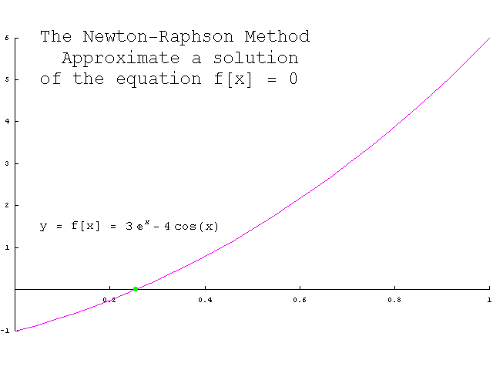
12

Slide 13
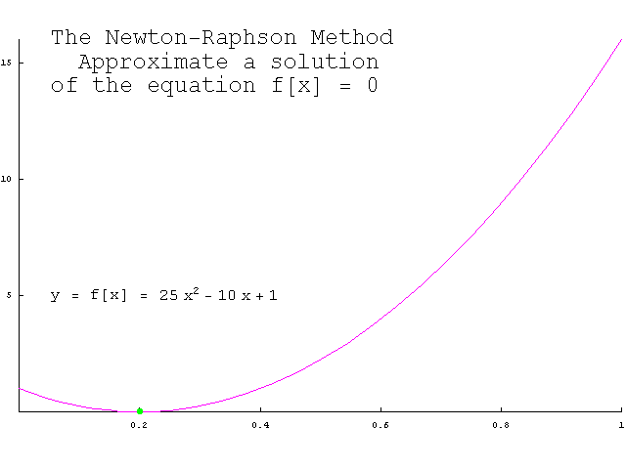
13

Slide 14
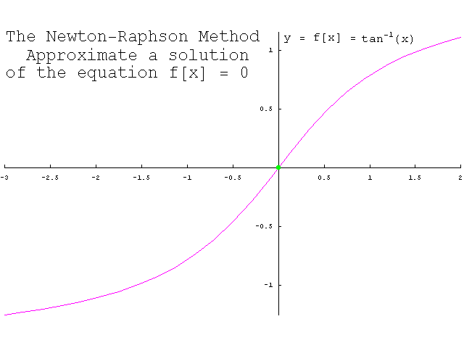
14

Slide 15
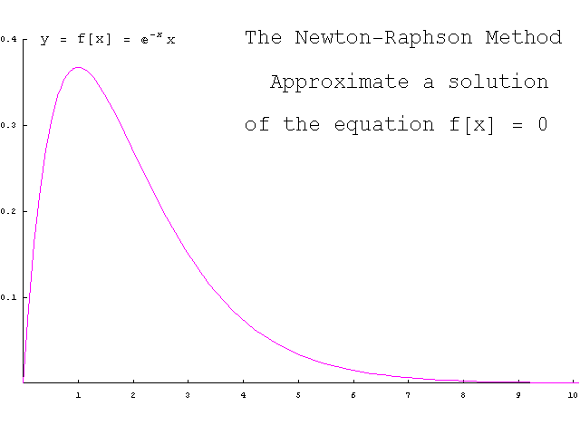
15

Slide 16
16

Slide 17
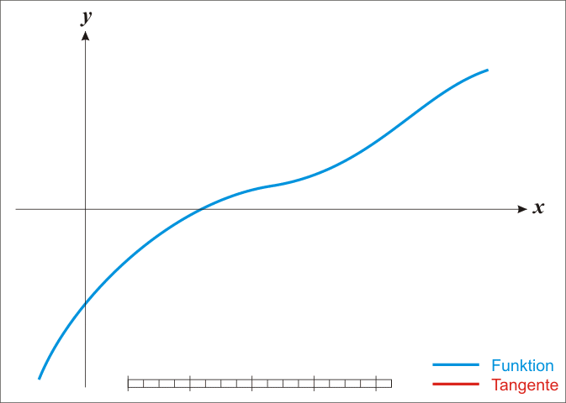
17

Slide 18
18
Lemma
Assume that and there exists a number α ∈ [a, b], where f(α) = 0.
If , then there exists a number δ > 0 such that the sequence defined by the iteration
will converges to α for any initial approximation

Slide 19
19
The Newton’s method uses the iteration function
is called the Newton’s iteration function.
Since f(α) = 0, it is easy to see that g(α) = α.
Thus the Newton’s iteration for finding the root of the equation
f(x) = 0
is accomplished by finding a fixed-point of the equation
g(x) = x.

Slide 20
20
Procedure (Newton’s Method)
1. Find the initial approximation
for the root by sketching the graph of the function.
2. Evaluate function f(x) and the derivative at initial approximation.
Check: if f(x0) = 0 then is the desire approximation to a root. But if , then go
back to step 1. to choose new approximation.
3. Establish Tolerance (ϵ > 0) value for the function.
4. Compute new approximation for the root by using the iterative formula
5. Check Tolerance. If , for n ≥ 0, then end; otherwise, go back to step 4., and repeat
the process.

Slide 22
Example
Use the Newton’s method to find the root of
that is located in the interval accurate to , take an initial approximation .

Slide 23
Solution:
Given
and so
Now evaluating f(x) and ________________at the
give approximation , gives

Slide 24
(♥)
الخوارزمية The algorithm


Slide 26
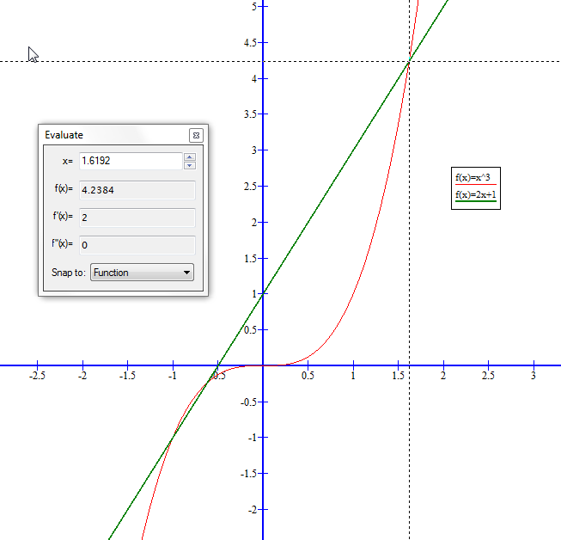

Slide 27
